Slide 1
FEED HOPE & NOURISH MAUI,
FROM FARM TO HUNGRY, WITH LOVE!
HHHMAUI.ORG - @HHHMAUI

Slide 2
HHHMAUI.ORG
Our Mission
We are dedicated to addressing basic human needs;
food, water, and shelter
for those facing hardship and food insecurity. Through self-organization and community stewardship, we envision a thriving Maui where we support one another, rooted in the spirit of Aloha ʻĀina.

Slide 3
HHHMAUI.ORG
How We Serve
Food sourced from local Maui farms, prepared with love by volunteers, and shared freely with those in need creates a meaningful connection from land to heart,
inspiring hope and nourishing the community.
We have found that when essentials are met, individuals can access their innate talents and inherent genius, fostering a collaborative and thriving community culture that grows naturally.

Slide 4
HHHMAUI.ORG
Our Story
From Pandemic to Fire Response
Founded during the pandemic in 2020, initially delivering meals to the unsheltered and gathering surplus produce from local farms.
Pivot in Response to Crisis: Expanded operations following the Maui wildfires in 2023. Grew from 20 to over 800 volunteers overnight to meet the growing need.
40000
2000
2231
3450
lbs of produce /week
meals a day
volunteers
contributors

Slide 5
HHHMAUI.ORG
Our Journey So Far
Partnerships
After the initial needs were addressed we setup Partner restaurants & kitchens to continue hot meal programs for survivors and Maui-hungry
Huamomona / Papi’s Ohana / Niu Life / Miss Arepa / A’a Roots / Story Maui / Rodeo General
March
2020
Serving the Hungry
Partnership with Whole Foods
& new kitchen at Anuhea Chappel
Operations continue with services
3 times per week
Aug
2023
May-Sep
2024
Pandemic
Co-Founder Bradley Kukral
begins making meals in Lahaina
Starting with 15 meals and expanding to
200 meals a day
Maui Wildfires
August 9th 2023 our volunteer base grew from 20 to 800
Emergency Response Programs
Food, Water, Gas, Clothing
Operation Starlink / Khalsa Aid 40klbs of Maui Farm Produce weekly / Hub Setup Honokowai, Maalaea Boat Ramp
HUB Support Napili Noho, Pohaku Park
Pivots & NCS
Maui Nui Strong HCF Grantee, NCS Hotel Meal Program organizer. New shared commercial kitchen
New office & Warehouse at GEM
Sep
2022
Aug- Dec
2023
Path to Resilence

Slide 6
HHHMAUI.ORG
Our Programs
Meals & Kitchens
Maui Farm Produce
We prepare and serve daily meals to the displaced and vulnerable through community kitchens and partner restaurants.
We collaborate with Khalsa Aid, Local Harvest and Maui farmers to bring fresh produce to kitchens, hubs, and directly to families in need of support.
Volunteer Network
Program Partnerships
We engage volunteers and local businesses to create a community support system.
Using web technology we quickly deploy resources & coordinate responses.
Through our partnerships with MEO for staffing and GEM for office space, we are building continuity, expanding resources, and fostering long-term sustainability.

Slide 7
HHHMAUI.ORG
What We Do
FARMS &
SUPPLIERS
MEALS &
KITCHENS
COMMUNITY &
VOLUNTEERS
WE COLLABORATE WITH MAUI FARMS & FOOD SUPPLIERS TO BRING FRESH PRODUCE TO THE COMMUNITY, KITCHENS & HUBS.
WE PREPARE AND SERVE NOURISHING MEALS TO THE UNSHELTERED AND DISPLACED, FROM MULTIPLE COMMUNITY KITCHENS & PARTNER RESTAURANTS.
WE PARTNER WITH VISITORS, MAUI VOLUNTEERS, LOCAL BUSINESSES, AND ORGANIZATIONS TO EXPAND COMMUNITY RESPONSE, RESILIENCE & IMPACT.

Slide 8
HHHMAUI.ORG
Partners

Slide 9
HHHMAUI.ORG
Partners

Slide 10
HHHMAUI.ORG
Infrastructure Partners
We partner with key non-profits organizations that support our infrastructure, staff, office, kitchens and operating budget.

Slide 11
HHHMAUI.ORG
Food Supply
Most of our food comes from Maui-based farms, with 50% of our produce funded by Khalsa Aid through Local Harvest, a Maui Farm Co-op warehouse. The remaining support comes from Maui Food Bank, Whole Foods, and private donations.

Slide 12
HHHMAUI.ORG
Why we do it?
"EVERY CHILD DESERVES A FULL STOMACH AND A HEART FULL OF HOPE."
IN THE AFTERMATH OF THE WILDFIRES, ACCESS TO NUTRITIOUS FOOD IS ESSENTIAL FOR FAMILIES REBUILDING THEIR LIVES. A CHILD’S ABILITY TO GROW, LEARN, AND THRIVE DEPENDS ON FOOD SECURITY—WITHOUT IT, BOTH HEALTH AND POTENTIAL ARE AT RISK. TOGETHER, WE CAN PROVIDE THE NOURISHMENT NEEDED TO HEAL, UPLIFT, AND STRENGTHEN OUR COMMUNITY, ENSURING NO ONE IS LEFT BEHIND.

Slide 13
HHHMAUI.ORG
Why we do it?
SUPPORTING THE HOUSELESS & DESTITUTE
SUPPORT TO THE HOUSELESS AND THOSE IN DESPERATE NEED, RAISING THE COLLECTIVE HUMANITY OF OUR COMMUNITY.
WHEN WE LIFT THE LOWEST BAR, WE ALL RISE TOGETHER—LIKE A TIDE THAT LIFTS ALL SHIPS. BY ADDRESSING THESE URGENT NEEDS, WE CONTRIBUTE TO COMMUNITY BEAUTIFICATION AND CRIME PREVENTION, ENSURING NO ONE HAS TO ENDURE THE INDIGNITY OF FINDING THEIR NEXT MEAL IN THE TRASH.
Maui fire survivors, the ALICE population, and those suffering from economic hardships need a hand to stay afloat. Without timely assistance during crises, individuals can slip through the cracks and experience a gradual decline that may lead to homelessness. No one suddenly becomes homeless—it’s a series of hardships without intervention. Our work is about providing that support and safety net during challenging times to keep individuals and families from falling further.
FIRE SURVIVORS AND ALICE

Slide 14
HHHMAUI.ORG
Why we do it?
SUPPORTING MAUI FARMERS & FOOD SOVEREIGNTY
NURTURING LOCAL AGRICULTURE FOR A RESILIENT FUTURE WE SUPPORT MAUI FARMERS AND PROMOTE FOOD SOVEREIGNTY TO ENSURE A HEALTHY, SUSTAINABLE COMMUNITY.
INVESTING IN LOCAL AGRICULTURE STRENGTHENS OUR FOOD SUPPLY CHAIN, MAKING IT MORE RESILIENT IN TIMES OF EMERGENCY AND CRISIS. WHEN WE PRIORITIZE LOCAL FOOD SOURCES, WE CREATE A SYSTEM THAT SUSTAINS US, BUILDS ECONOMIC STABILITY, AND PROTECTS OUR ISLAND FROM DISRUPTIONS.
BY EMPOWERING FARMERS, WE NOT ONLY FOSTER A HEALTHIER MAUI BUT ALSO ENSURE THAT, WHEN TIMES ARE TOUGH, OUR COMMUNITY REMAINS NOURISHED AND SECURE.

Slide 15
HHHMAUI.ORG
Community
is the immunity
Together, we can overcome challenges and achieve more by supporting one another. We believe in the power of a shared vision, harnessing our unique strengths and collaborating for lasting impact.

Slide 16
HHHMAUI.ORG
221,378 lbs
Maui Farmed Produce
delivered
Fresh, locally-sourced produce is delivered to Maui fire survivors, creating a win-win scenario by supporting local farmers and promoting food sovereignty to build a resilient, self-sustaining community.
In the immediate aftermath of the Maui wildfires, we mobilized quickly to distribute over 10,000 pounds of produce twice a week, to kitchens, community hubs, and families affected by the disaster.

Slide 17
HHHMAUI.ORG
560,415 meals
delivered
Nurishing Meals
Meals are vital during crises because they provide more than just nourishment; they offer comfort, connection, and a sense of normalcy.
Across all cultures, gathering around a meal fosters community and shared strength, helping people feel supported and less alone. In times of hardship, a warm, nutritious meal can be a beacon of hope, reinforcing bonds and resilience within the community.

Slide 18
HHHMAUI.ORG
People Power
2231 volunteers
mobilized
Maui united as locals and visitors came together, offering time, resources, and support. This collective effort showcased the island's aloha spirit and strengthened community bonds during challenging times.
During our relief efforts, volunteers joined our organization, contributing to various programs based on their skills and abilities. We see a powerful opportunity to bridge the gap between tourism and sustainability by fostering volunteerism. Engaging visitors in meaningful community efforts not only strengthens Maui’s resilience but also promotes a deeper connection and shared responsibility for the island’s well-being.

Slide 19
HHHMAUI.ORG
The Road Ahead Where We’re Going
CURRENT FOCUS:
STRENGTHENING FOOD SECURITY THROUGH MAUI-FARMED PRODUCE
IMPROVING KITCHEN OPERATIONS TO SUPPORT THE HOT MEALS PROGRAM
BUILDING RELATIONSHIPS WITH FUNDING SPONSORS TO SUSTAIN PROGRAMS
PILOT PROGRAMS:
MAUI COMMUNITY FRIDGE COLLECTIVE
MAUI CENTRAL KITCHEN
Reach more families caught in the fallout WHILE UPLIFTING THE COMMUNITY SUFFERING FROM THE ECONOMIC DECLINE
INCREASE MEAL CAPACITY, PUT VOLUNTEERS TO WORK, OPEN THE KITCHEN TO PARTNER ORGANIZATIONS, AND CREATE DONATION-BASED PRODUCTS TO SUSTAIN OUR PROGRAMS

Slide 20
HHHMAUI.ORG
Path to Resilience
Maui Central Kitchen
Community
Leadership
Training
Dec
2024
May
2025
Nov
2025
Maui Community Fridge Collective
Pilot program to address the ALICE community and lift spirits
Sustainable Donation Products
Financial
Resilience
Jan
2025
Sep
2025

Slide 21
HHHMAUI.ORG
Pilot Programs
MAUI COMMUNITY FRIDGE COLLECTIVE
MAUI CENTRAL KITCHEN
Why this program is important
Why this program is important
The ALICE community—Asset Limited, Income Constrained, Employed—faces significant risks from crises like Maui Wildfires, illness, family or financial burdens, and rising costs, which can lead to instability and eventual homelessness.
Supporting helps prevent homelessness and ensures families and individuals receive nutrition and moral support. The Maui Community Fridge Collective programs play a vital role in offering consistent access to food, fostering stability, and strengthening community resilience.
Witnessing homelessness and community members suffering affects us all—it challenges our collective humanity. When we uplift those most vulnerable, we strengthen our entire society. Our kitchen not only addresses immediate food needs but also stands ready for emergency response, ensuring meals are available in any crisis.
Beyond emergency aid, this kitchen will be a shared resource for community programs across Maui, fostering collaboration and resilience. Additionally, developing donation-based products will help sustain our efforts, ensuring continued support for those in need.

Slide 22
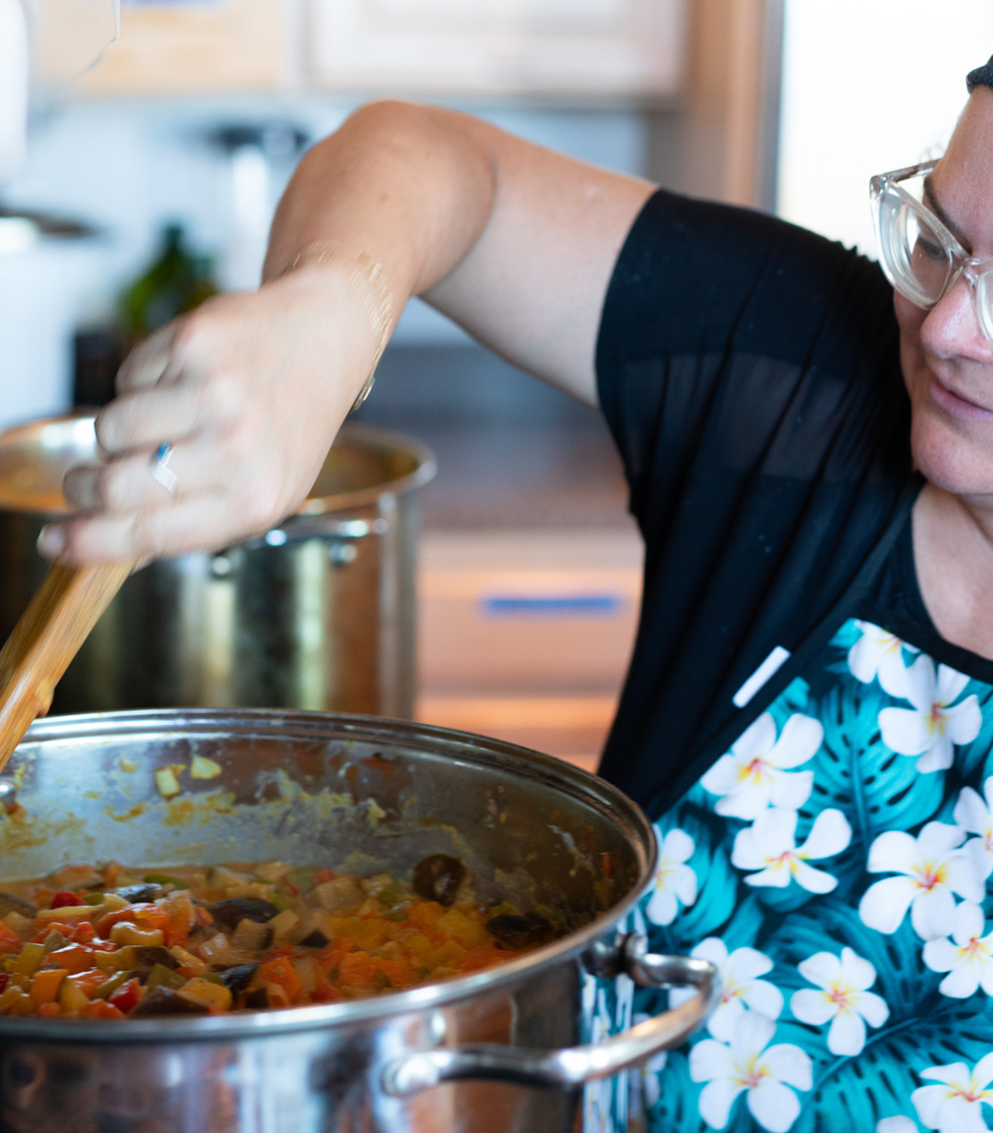
HHHMAUI.ORG
We need you!
Volunteer, Donate, or become a program sponsor!
Your support is vital to keep our essential programs running. By sponsoring our initiatives, you contribute directly to strengthening food security, sustaining our kitchen operations, and providing vital resources for those facing hardship.
Your partnership helps ensure fresh, local produce reaches families, hot meals continue for the hungry, and new projects, like our community fridge program, become a reality.
Together, we can create lasting change and a resilient, thriving Maui. We need your commitment to keep this mission alive—join us in uplifting our community.
When you talk about food people don't want a solution one week from now, one month from now.
The solution has to be now.

Slide 23
HHHMAUI.ORG
Ways You Can Help
SUPPLIES AND WISHLIST
FINANCIAL DONATION
PROGRAM SPONSOR
Amazon Wishlist
Single or Recuring Donation
Fund a Fridge or Kitchen
Your generous contributions of supplies or items from our Amazon Wishlist go directly to stocking our kitchens and supporting our relief efforts. Every item you donate plays a vital role in sustaining our programs and providing immediate aid to those who need it most.
Your one-time or recurring financial donations empower us to continue preparing meals, delivering produce, and offering support to Maui communities. With your help, we can extend our reach, maintain operations, and respond quickly during times of crisis.
By sponsoring a program like a community fridge or kitchen, you help lay the foundation for sustainable support and long-term community resilience. Your sponsorship ensures we can expand our services, nourish more individuals, and fortify our mission to serve Maui.
Amazon
GiveButter
Reach Out

Slide 24
Meet the Leadership Team
HHHMAUI.ORG
Together we grow
Rachel, Naim, and Sophelia each bring unique strengths and diverse skills to the table, creating a dynamic team that embodies dedication, compassion, and vision.
Rachel, our Executive Director, ensures everything runs smoothly with her unwavering commitment and meticulous attention to detail. From HR and accounting to volunteer operations, she keeps everything on track and the team accountable.
Naim, co-founder and community leader, brings experience in tech, media, and manufacturing, along with deep ties in the community, with a mission to connect people, place, and purpose.
Sophelia, born and raised in Maui, brings deep roots in community service. Her expertise in organizational development and people management ensures our programs stay impactful, efficient, and reliable.
Together, they form a strong, collaborative team that leads with heart and drives forward the mission of our programs.
Rachel Tarver
Executive Director
Sophelia Oberlander
Naim Ferguson
Co-Founder
Director of Impact
Director of Operations

Slide 25
Meet the Leadership Team
HHHMAUI.ORG
Together we grow
Rachel, Naim, and Sophelia each bring unique strengths and diverse skills to the table, creating a dynamic team that embodies dedication, compassion, and vision.
Naim Ferguson
Co-Founder
Director of Impact
Naim, co-founder and community leader, brings experience in tech, media, and manufacturing, along with deep ties in the community, with a mission to connect people, place, and purpose.
Sophelia Oberlander
Rachel Tarver
Director of
Operations
Executive Director
Sophelia, born and raised in Maui, brings deep roots in community service. Her expertise in organizational development and people management ensures our programs stay impactful, efficient, and reliable.
Together, they form a strong, collaborative team that leads with heart and drives forward the mission of our programs.
Rachel, our Executive Director, ensures everything runs smoothly with her unwavering commitment and meticulous attention to detail. From HR and accounting to volunteer operations, she keeps everything on track and the team accountable.
Director of Operations

Slide 26
HHHMAUI.ORG

Slide 27
HHHMAUI.ORG
Where to Find Us
Kahana Ramp
Hub
Community Pantry
@Story Maui
Huamamona
Kitchen @Fond
HHH Office
@ GEM
HHH Kitchen
@ Happy Opu
Pohaku Park Hub
(S-Turns)
HHH Truck Fleet
Local Harvest
Farm Co-Op
Community Pantry
@Rodeo General
Saint Theresa
Anuhea
Maui Rescue Mission

Slide 28
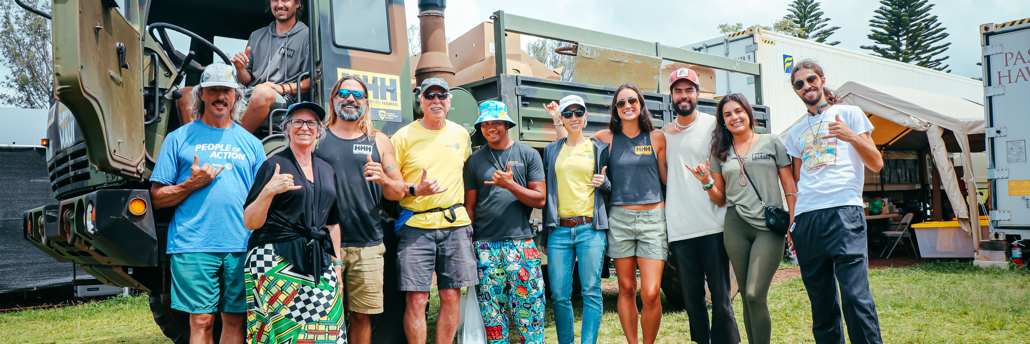
HHHMAUI.ORG
Get in touch!
Naim, Rachel, and Sophelia are available to answer any questions, provide a tour of our operations, and meet with you to share our vision. We aim to foster partnership, connection, and ensure accountability to our mission and your valued contribution.
349 Hanakai Street, Kahului, HI 96732
808-276-6673
aloha@hhhmaui.org
HHHmaui.org

Slide 29
HHHMAUI.ORG
MAHALO
THANK YOU FOR YOUR TIME AND CONSIDERATION IN SUPPORTING OUR PROGRAMS AND COMMUNITY RESILIENCE. WE NEED YOU TO HELP CONTINUE THIS MISSION AND MAKE A LASTING IMPACT.
TOGETHER, WE CAN CREATE MEANINGFUL CHANGE.
HHHMAUI.ORG

